Slide 1
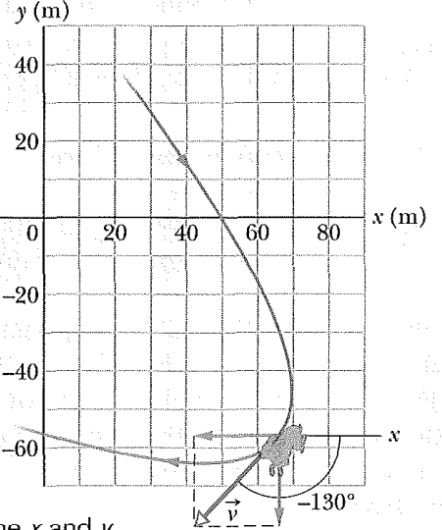
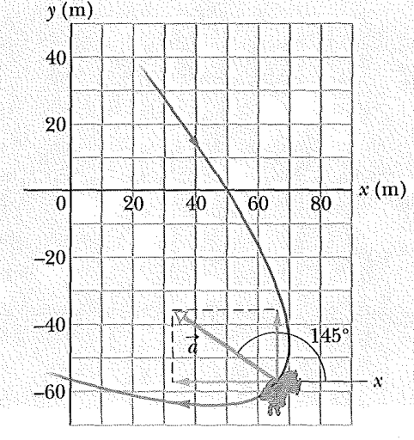
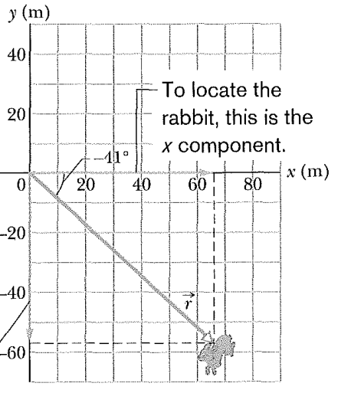
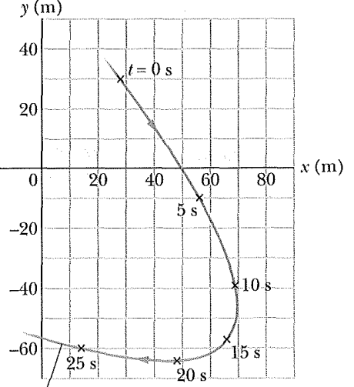

A rabbit runs across a parking lot on which a set of coordinate axes has, strangely enough, been drawn. The coordinates (meters) of the rabbit’s position as function of time t (seconds) are given by
$x=−0.31t^{2}+7.2t+28$
$y=0.22t^{2}−9.1t+30$
At t=15 s, what is the rabbit’s position vector $\vec{r}$ in unit-vector notation and in magnitude-angle notation?
Find the velocity $\vec{v}$ at time t=15 s in unit vector notation and magnitude-angle notation.
Find the acceleration $\vec{a}$ at time t=15 s in unit vector notation and magnitude-angle notation.

Slide 2
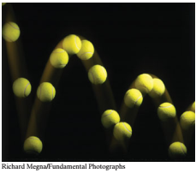
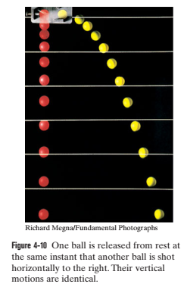
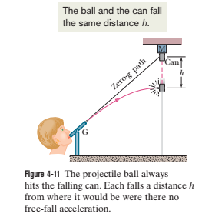

Slide 3
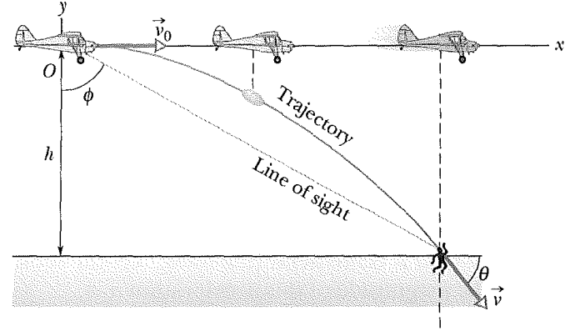
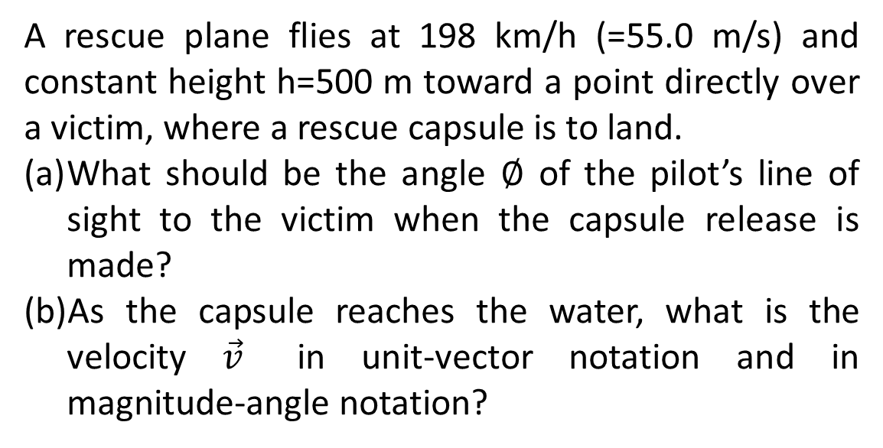
A rescue plane flies at 198 km/h (=55.0 m/s) and constant height h=500 m toward a point directly over a victim, where a rescue capsule is to land.
What should be the angle $∅$ of the pilot’s line of sight to the victim when the capsule release is made?
As the capsule reaches the water, what is the velocity $\vec{v}$ in unit-vector notation and in magnitude-angle notation?

Slide 4
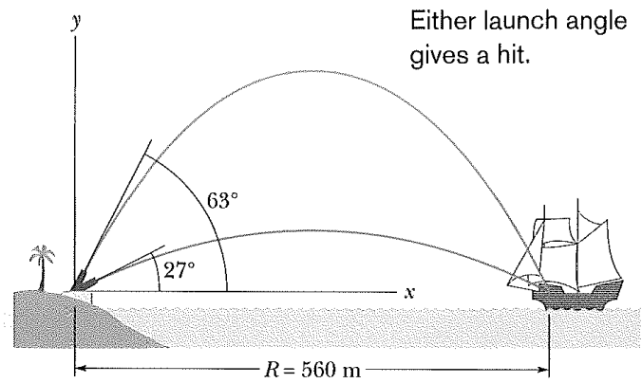
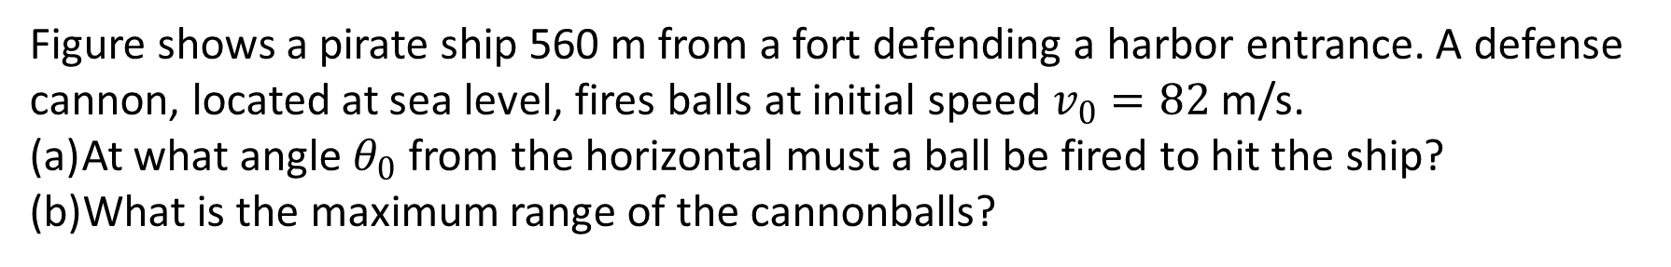
Figure shows a pirate ship 560 m from a fort defending a harbor entrance. A defense cannon, located at sea level, fires balls at initial speed $v_{0}=82$ m/s.
At what angle $θ_{0}$ from the horizontal must a ball be fired to hit the ship?
What is the maximum range of the cannonballs?

Slide 5
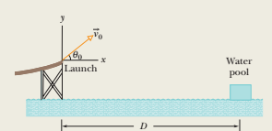
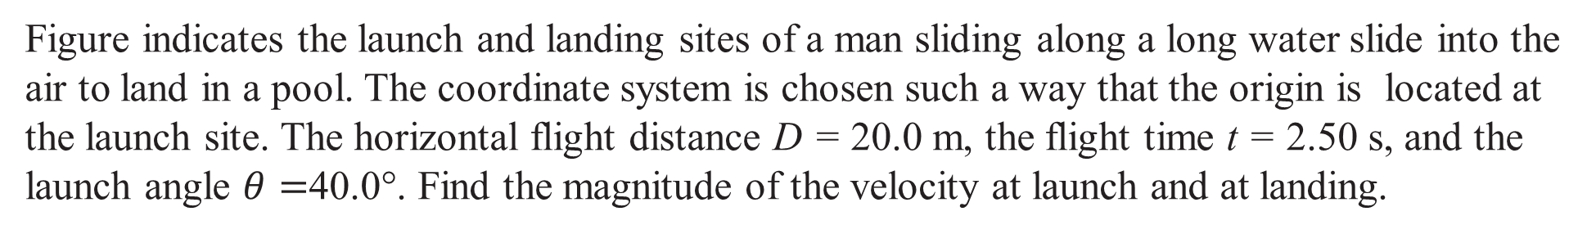
Figure indicates the launch and landing sites of a man sliding along a long water slide into the air to land in a pool. The coordinate system is chosen such a way that the origin is located at the launch site. The horizontal flight distance D = 20.0 m, the flight time t = 2.50 s, and the launch angle $θ=$40.0°. Find the magnitude of the velocity at launch and at landing.

Slide 6
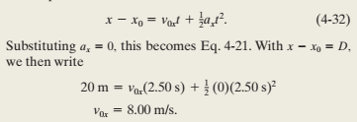
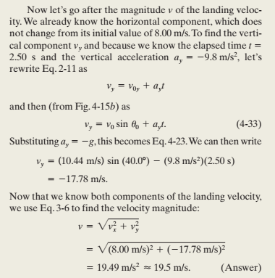
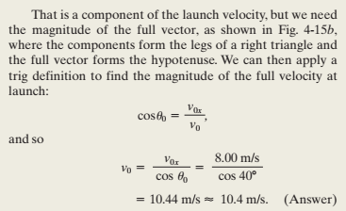

Slide 7
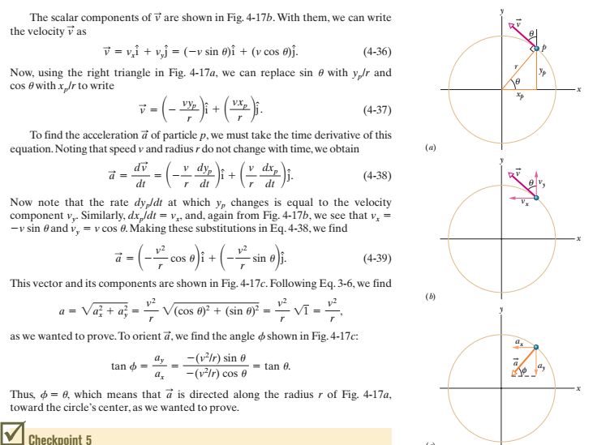

Slide 8
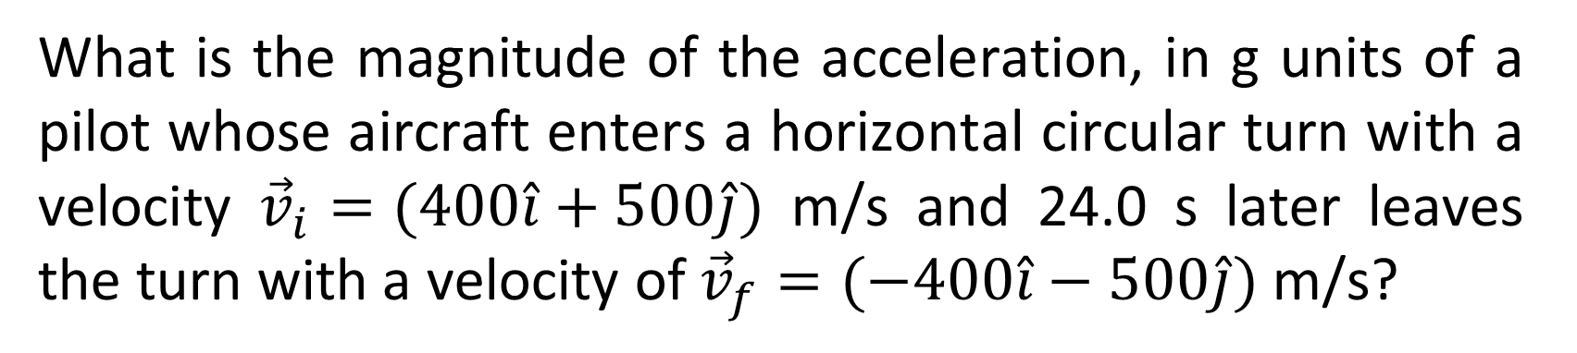
What is the magnitude of the acceleration, in g units of a pilot whose aircraft enters a horizontal circular turn with a velocity ${\vec{v}}_{i}=(400\hat{i}+500\hat{j})$ m/s and 24.0 s later leaves the turn with a velocity of ${\vec{v}}_{f}=(−400\hat{i}−500\hat{j})$ m/s?

